Slide 1
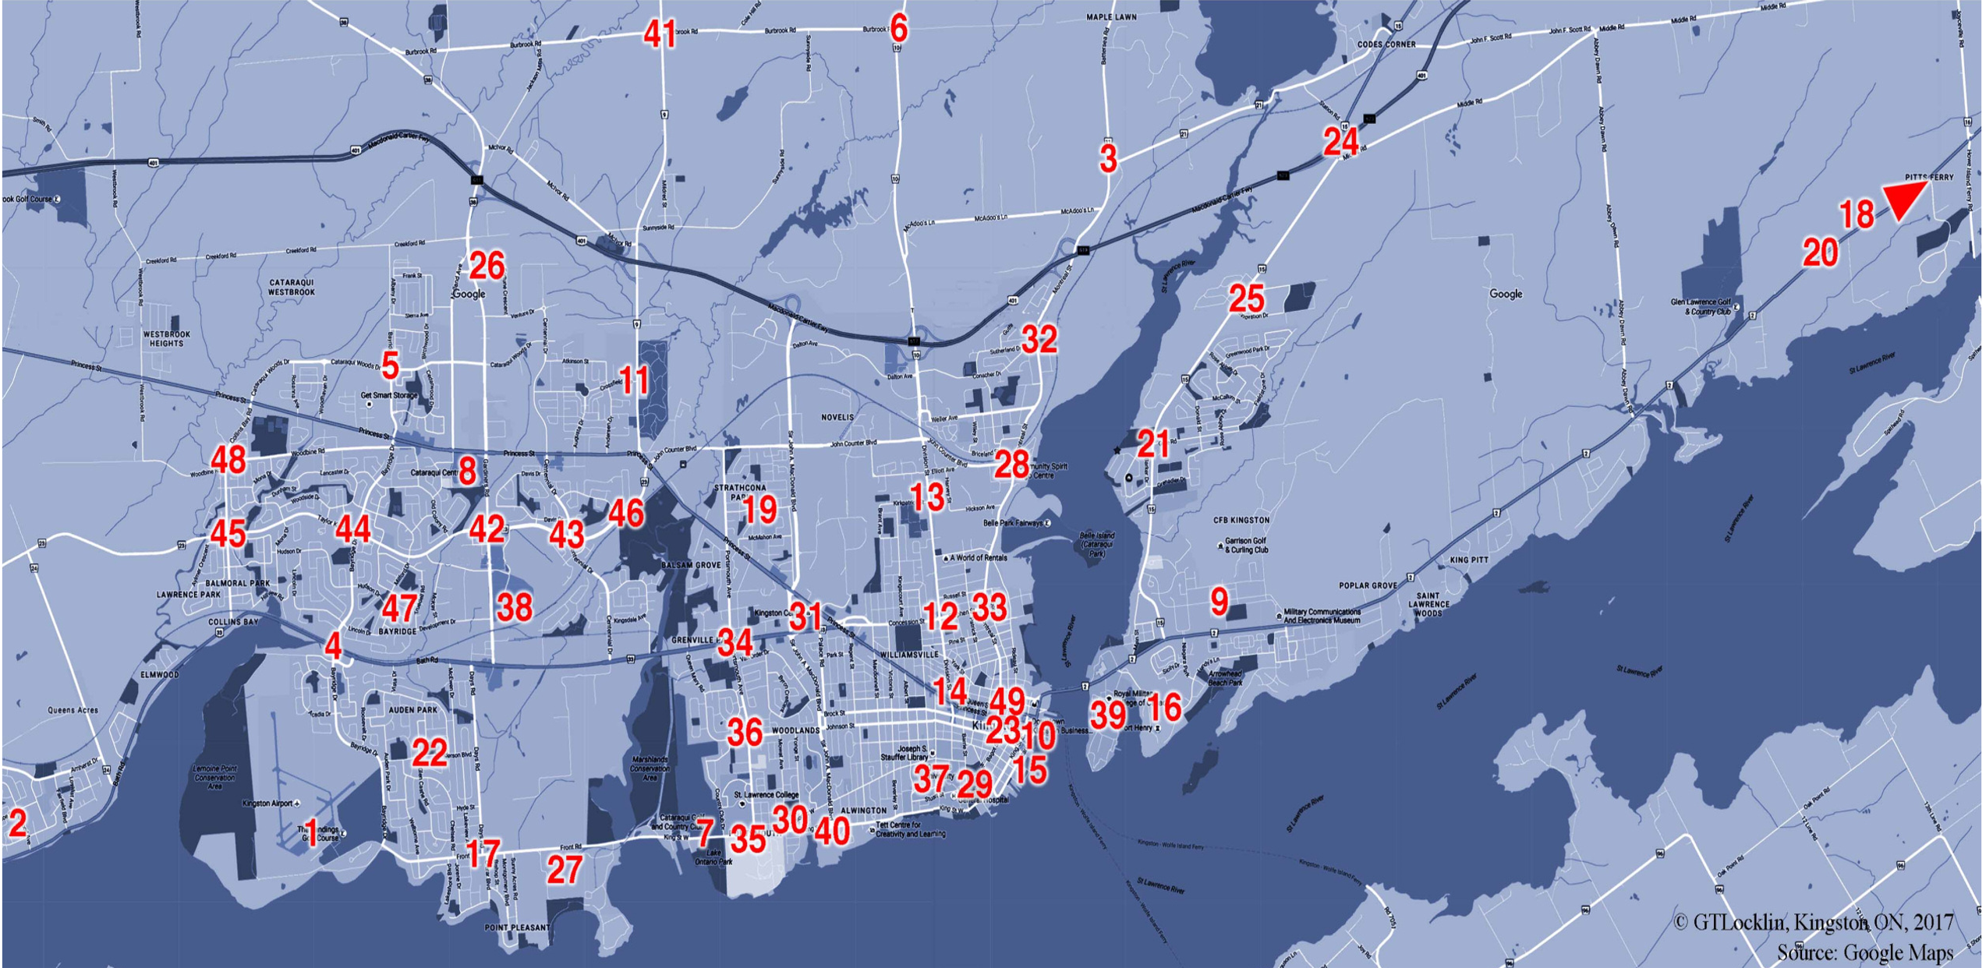
Distance Comparison from Residential Areas to 6 Employment Areas
Bridge

Slide 2
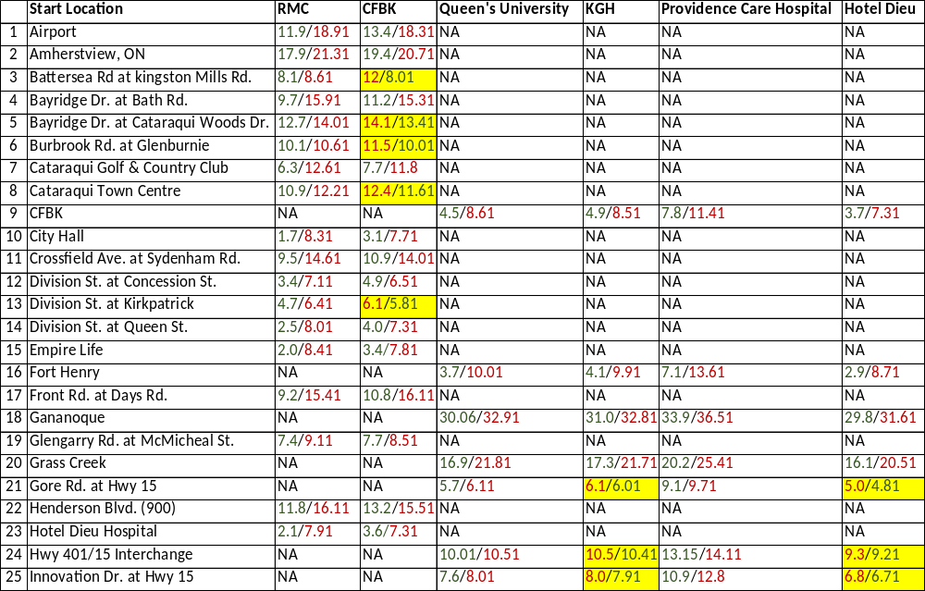
Distance: causeway/Bridge in kms

Slide 3
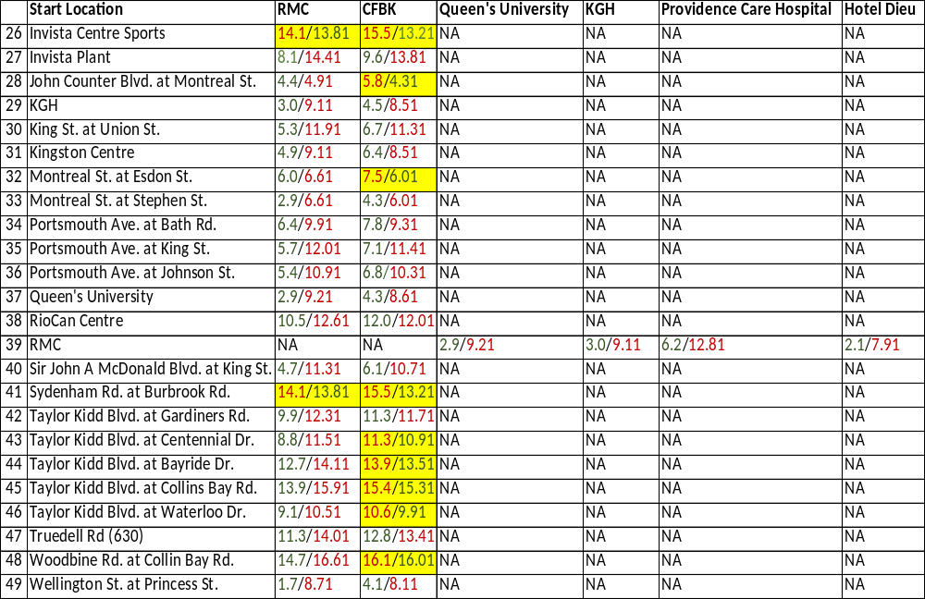
Distance: causeway/Bridge in kms

Slide 4
Commuter Traffic Data Conclusions
Driving from 49 starting locations to 6 major employment centres yields 294 possible routes.
Only 22 routes or 7.5% of the total would find the bridge to be a shorter commute than the causeway.
If any of the other 272 routes or 92.5% of possible routes decided to use the bridge they would add to the carbon foot print.
Of the 22 routes that found a distance savings taking the bridge over the causeway, the average saved distance was 0.8 km.
We are spending $180 Million building this bridge to help 7.5% of commuters to 6 major employment areas save 0.8 km.

Slide 5
Commuter Traffic Data Conclusions
180 out of 294 routes, 61% do not need to cross the river to get to the 6 major employment areas.
92 routes or 31% would still find the causeway to be the best route.

